Slide 1
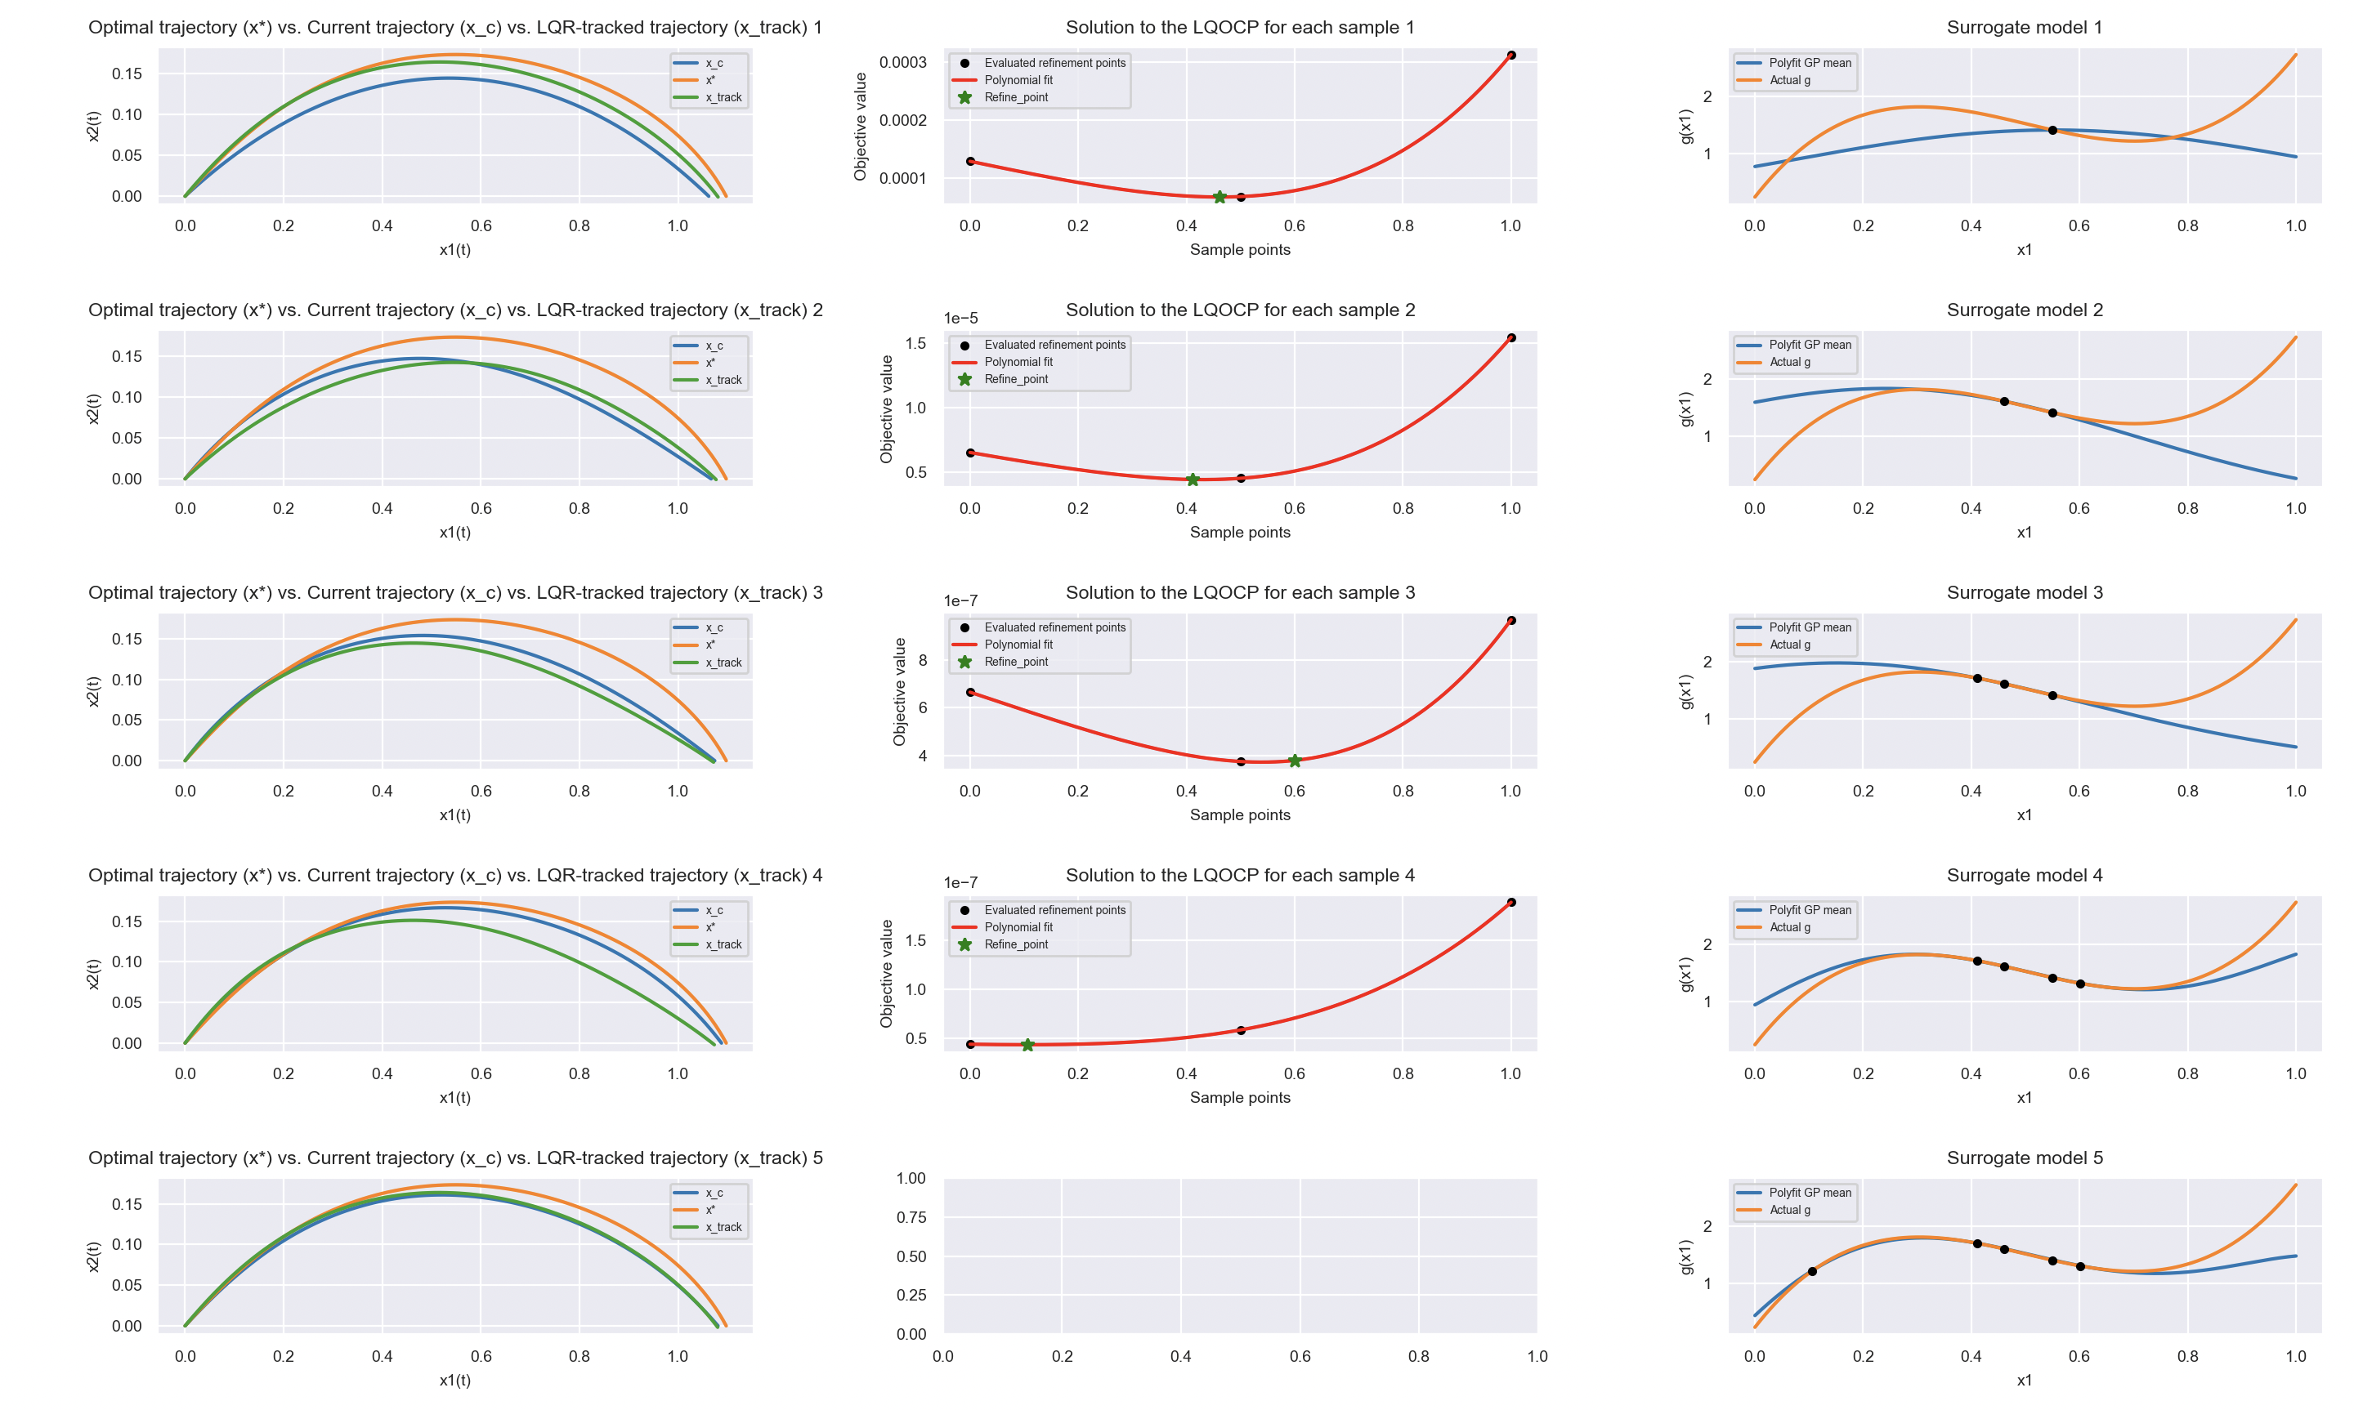
From last time:
We were interested in finding more efficient way to optimize the sensitivity function, instead of just evaluating a set of equally-spaced points over the domain.
Particularly, we wanted to try exploiting the convexity/ potential quadratic-ness of the function.
Fitting a second-degree polynomial to 3 equally-spaced sample points worked quite well and fitting a fourth-degree polynomial to 6 points was almost a perfect fit.
How can we improve on this?

Slide 2
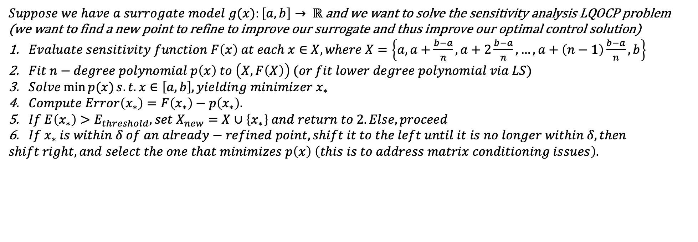
First Improvement: Simple form of EGO
One problem with this approach is that we don’t know how close the computed minimizer is to the real minimizer.
We can evaluate the sensitivity function at the computed point to check how accurately the polynomial matched the real function.
If the error lies above a certain threshold, we assume that our current estimate is inaccurate and we compute a new regression using the additional point, and repeat the process.
We stop once the error is below a desired threshold.
$Suppose we have a surrogate model g(x):\left[a,b\right]→ ℝ$ and we want to solve the sensitivity analysis LQOCP problem
(we want to find a new point to refine to improve our surrogate and thus improve our optimal control solution)
$Evaluate sensitivity function F\left(x\right) at each x∈X, where X=\left\{a,a+\frac{b−a}{n},a+2\frac{b−a}{n},…,a+\left(n−1\right)\frac{b−a}{n},b\right\}$
$Fit n−degree polynomial p\left(x\right) to \left(X,F\left(X\right)\right) (or fit lower degree polynomial via LS)$
$Solve\min{p(x)}s.t. x∈\left[a,b\right], yielding minimizer x_{∗}$
$Compute Error\left(x_{∗}\right)=F\left(x_{∗}\right)−p\left(x_{∗}\right).$
$If E\left(x_{∗}\right)>E_{threshold}, set X_{new}=X∪\left\{x_{∗}\right\} and return to 2. Else, proceed$
$If{ x}_{∗} is within δ of an already−refined point, shift it to the left until it is no longer within$ $δ, then$
$shift right, and select the one that minimizes p\left(x\right) \left(this is to address matrix conditioning issues\right).$

Slide 3
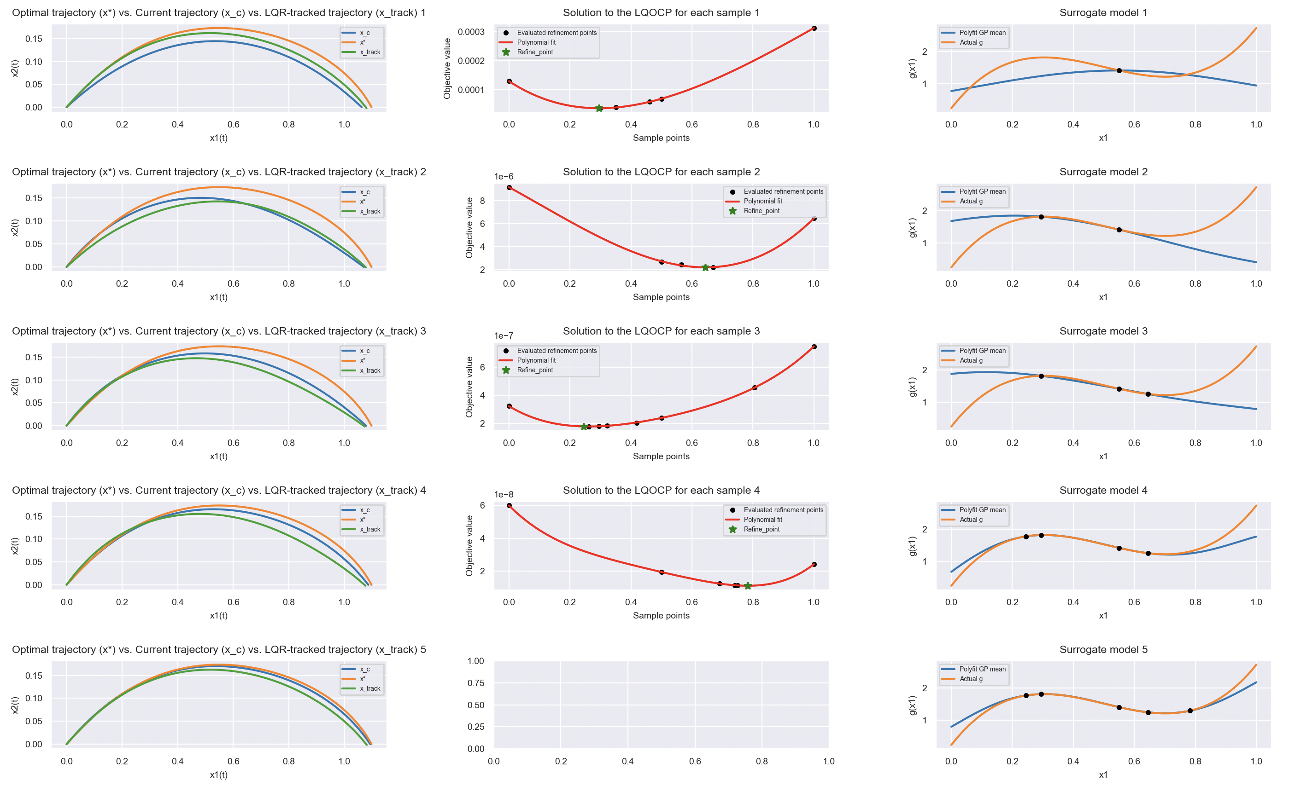

Slide 4

$Post−Refinement Error =\left\|\left\langle \left\|{x1}_{∗}−{x1}_{c}\right\|,\left\|{x2}_{∗}−{x2}_{c}\right\|\right\rangle \right\|$, where $\left\langle {x1}_{∗}, {x2}_{∗}\right\rangle$ is the actual open-loop trajectory, and $\left\langle {x1}_{c},{x2}_{c}\right\rangle$ is the one computed with the surrogate model
Post Refinement Error for naïve polynomial interpolation:
Roughly 0.15
Post Refinement Error for EGO:
Roughly 0.05
Major improvement at the expense of more LQOCP computations. However, we still end up with much better error than if we did the same number of LQOCP computations over a uniformly-space set of points. EGO allows us to focus our computations at the most relevant values rather than wasting computations at values far from the minimum.
But what if the sensitivity function isn’t convex?
We can use a Gaussian Process to build a surrogate model for the sensitivity problem.
We can view this as a Bayesian optimization problem, where we have a black-box function (F(x), the sensitivity function), which we wish to optimize.
We don’t have access to gradient information, but we can exploit general smoothness/covariance properties in order to intelligently update our model and converge on an optimal solution.
A Gaussian Process provides us with a way to quantify uncertainty which is useful

Slide 5
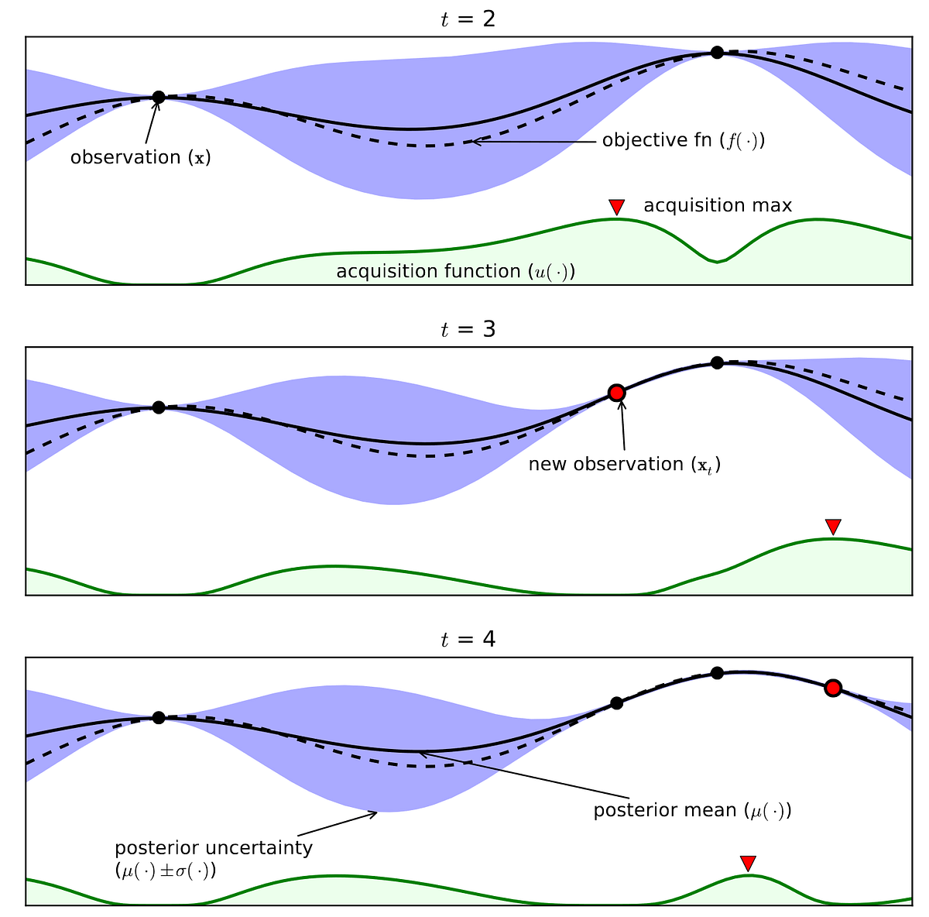
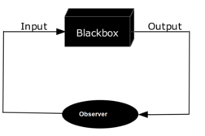
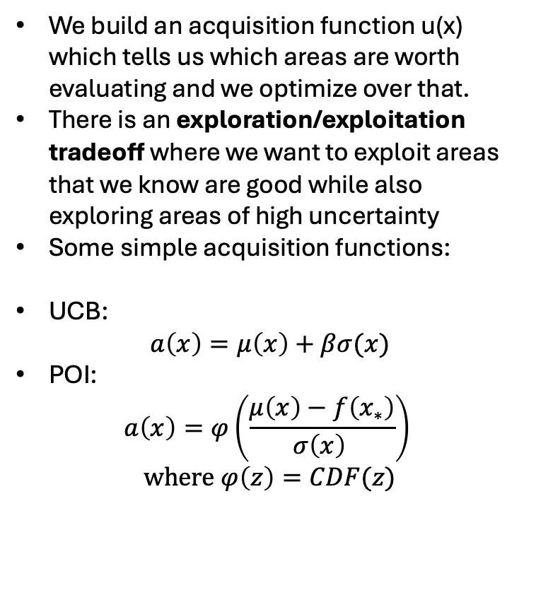
We build an acquisition function u(x) which tells us which areas are worth evaluating and we optimize over that.
There is an exploration/exploitation tradeoff where we want to exploit areas that we know are good while also exploring areas of high uncertainty
Some simple acquisition functions:
UCB:
$$a\left(x\right)=μ\left(x\right)+βσ(x)$$
POI:
$$a\left(x\right)=φ\left(\frac{μ\left(x\right)−f\left(x_{∗}\right)}{σ\left(x\right) }\right)$$
$$where φ\left(z\right)=CDF(z)$$

Slide 6
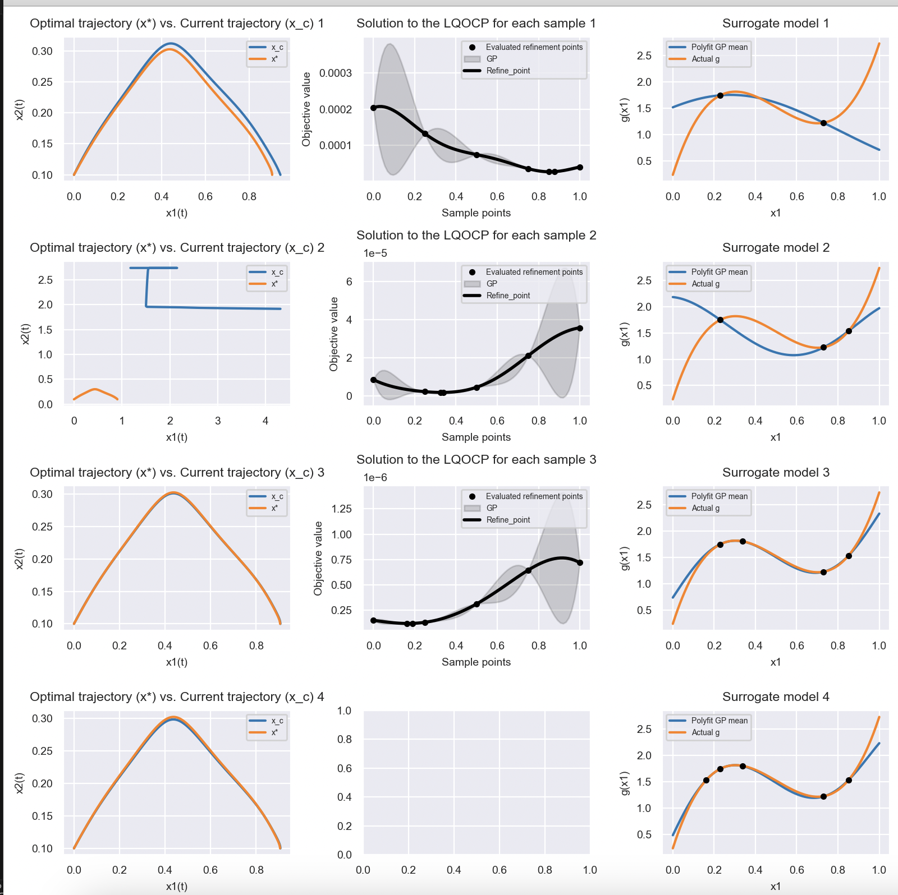
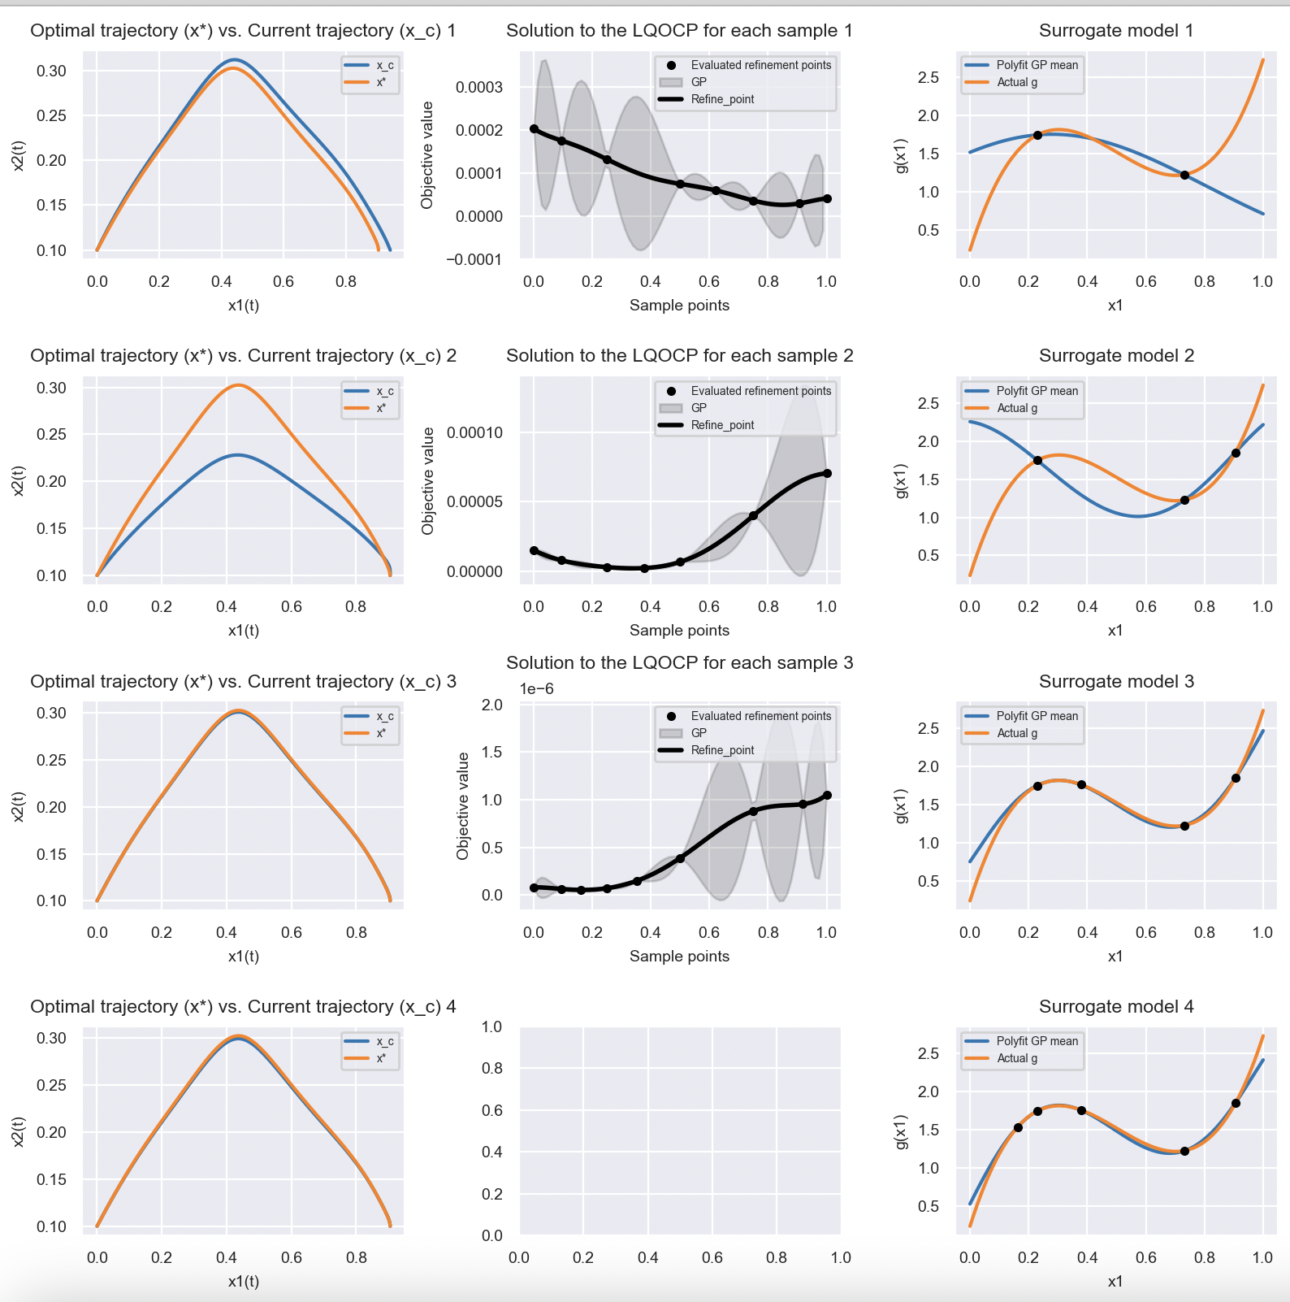
Upper Confidence Bound (prioritize exploring regions of high uncertainty)
Min. Expected Value (prioritize exploiting regions with low value)

Slide 7
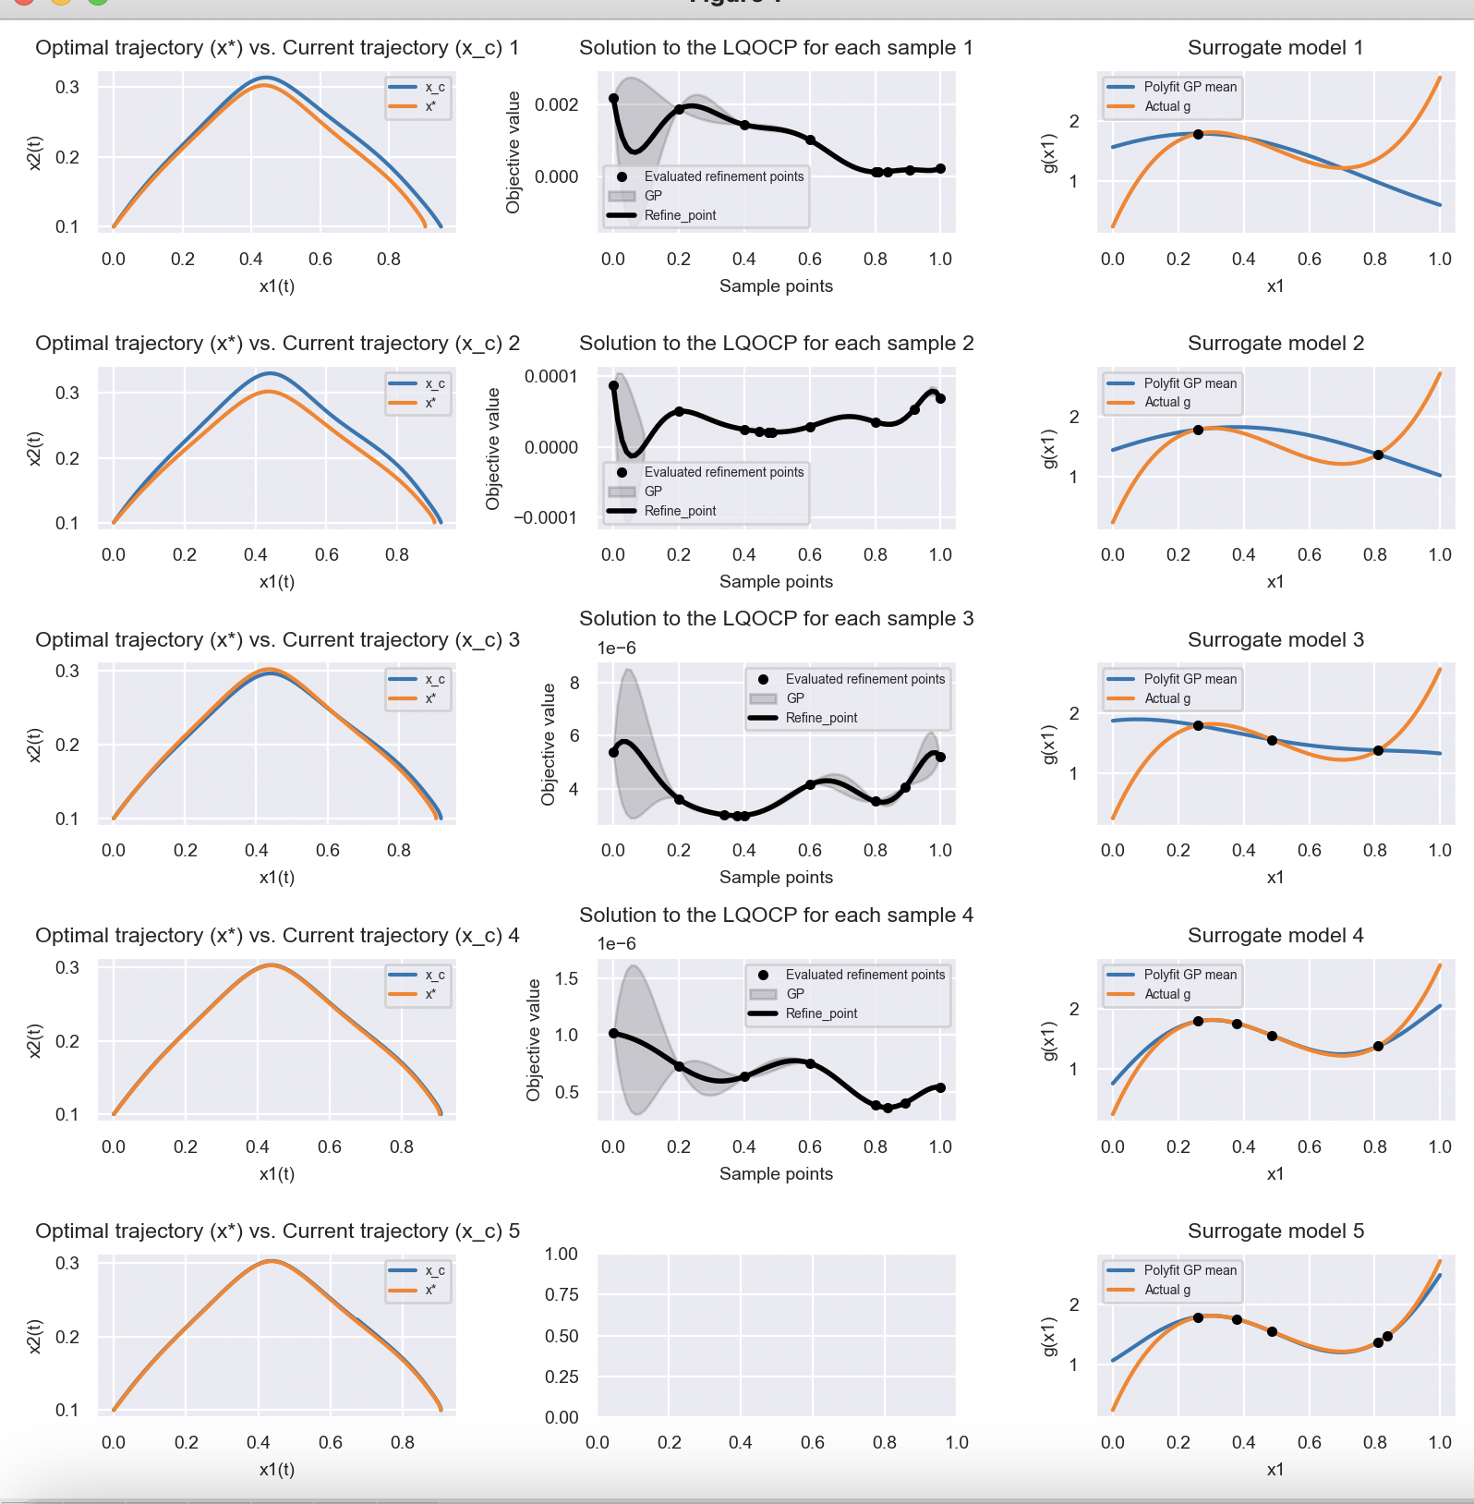
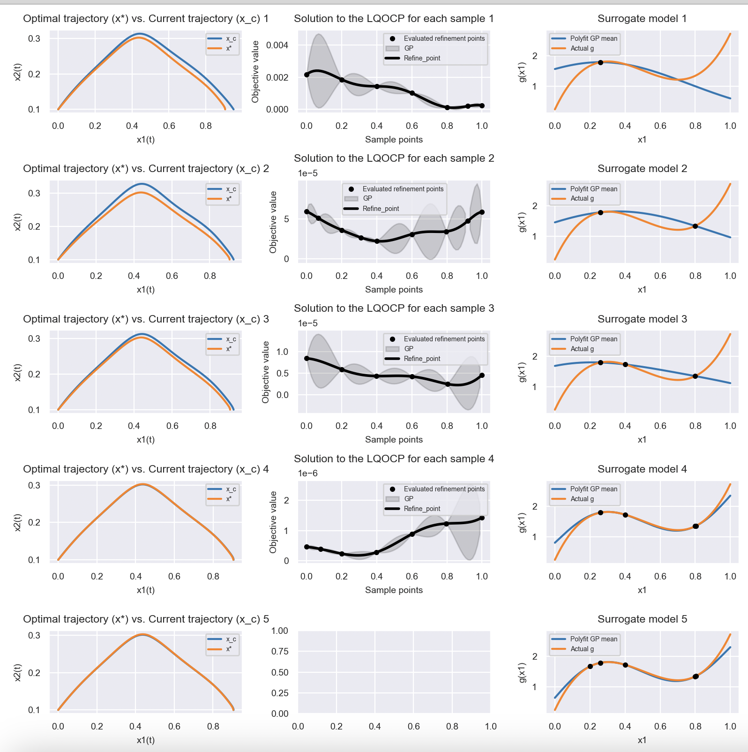
Upper Confidence Bound (prioritize exploring regions of high uncertainty)
Min. Expected Value (prioritize exploiting regions with low value)

Slide 8
Things to investigate:

